Slide 1
Chapter 2: Operating-System Services

Slide 2
Outline
Operating System Services
User and Operating System-Interface
System Calls
System Services
Linkers and Loaders
Why Applications are Operating System Specific
Design and Implementation
Operating System Structure
Building and Booting an Operating System
Operating System Debugging

Slide 3
Objectives
Identify services provided by an operating system
Illustrate how system calls are used to provide operating system services
Compare and contrast monolithic, layered, microkernel, modular, and hybrid strategies for designing operating systems
Illustrate the process for booting an operating system
Apply tools for monitoring operating system performance
Design and implement kernel modules for interacting with a Linux kernel

Slide 4
Operating System Services
Operating systems provide an environment for execution of programs and services to programs and users
One set of operating-system services provides functions that are helpful to the user:
User interface - Almost all operating systems have a user interface (UI).
Varies between Command-Line (CLI), Graphics User Interface (GUI), touch-screen, Batch
Program execution - The system must be able to load a program into memory and to run that program, end execution, either normally or abnormally (indicating error)
I/O operations - A running program may require I/O, which may involve a file or an I/O device
File-system manipulation - The file system is of particular interest. Programs need to read and write files and directories, create and delete them, search them, list file Information, permission management.

Slide 5
Operating System Services (Cont.)
One set of operating-system services provides functions that are helpful to the user (Cont.):
Communications – Processes may exchange information, on the same computer or between computers over a network
Communications may be via shared memory or through message passing (packets moved by the OS)
Error detection – OS needs to be constantly aware of possible errors
May occur in the CPU and memory hardware, in I/O devices, in user program
For each type of error, OS should take the appropriate action to ensure correct and consistent computing
Debugging facilities can greatly enhance the user’s and programmer’s abilities to efficiently use the system

Slide 6
Operating System Services (Cont.)
Another set of OS functions exists for ensuring the efficient operation of the system itself via resource sharing
Resource allocation - When multiple users or multiple jobs running concurrently, resources must be allocated to each of them
Many types of resources - CPU cycles, main memory, file storage, I/O devices.
Logging - To keep track of which users use how much and what kinds of computer resources
Protection and security - The owners of information stored in a multiuser or networked computer system may want to control use of that information, concurrent processes should not interfere with each other
Protection involves ensuring that all access to system resources is controlled
Security of the system from outsiders requires user authentication, extends to defending external I/O devices from invalid access attempts

Slide 7
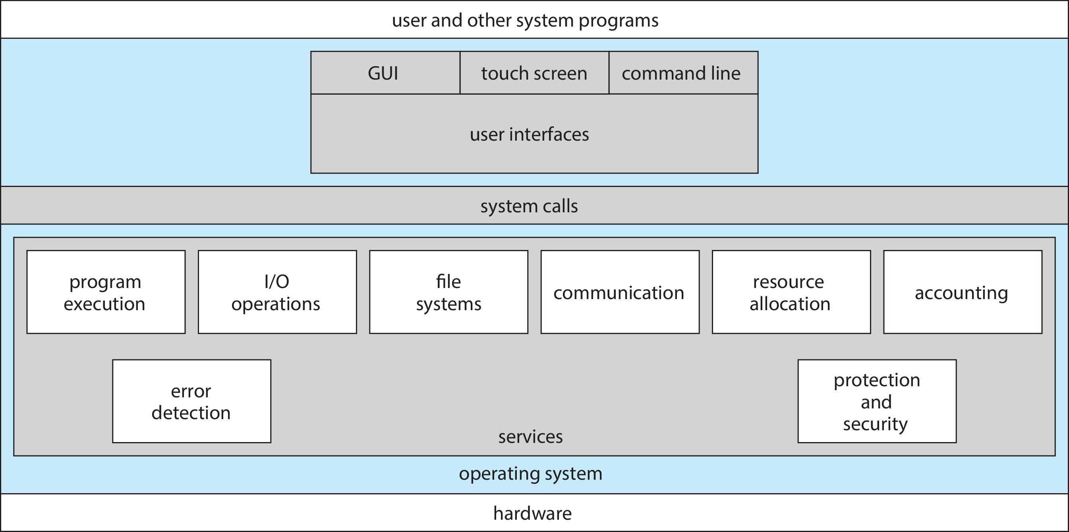
A View of Operating System Services

Slide 8
User interfaces

Slide 9
Command Line interpreter
CLI allows direct command entry
Sometimes implemented in kernel, sometimes by systems program
Sometimes multiple flavors implemented – shells
Primarily fetches a command from user and executes it
Sometimes commands built-in, sometimes just names of programs
If the latter, adding new features doesn’t require shell modification

Slide 10
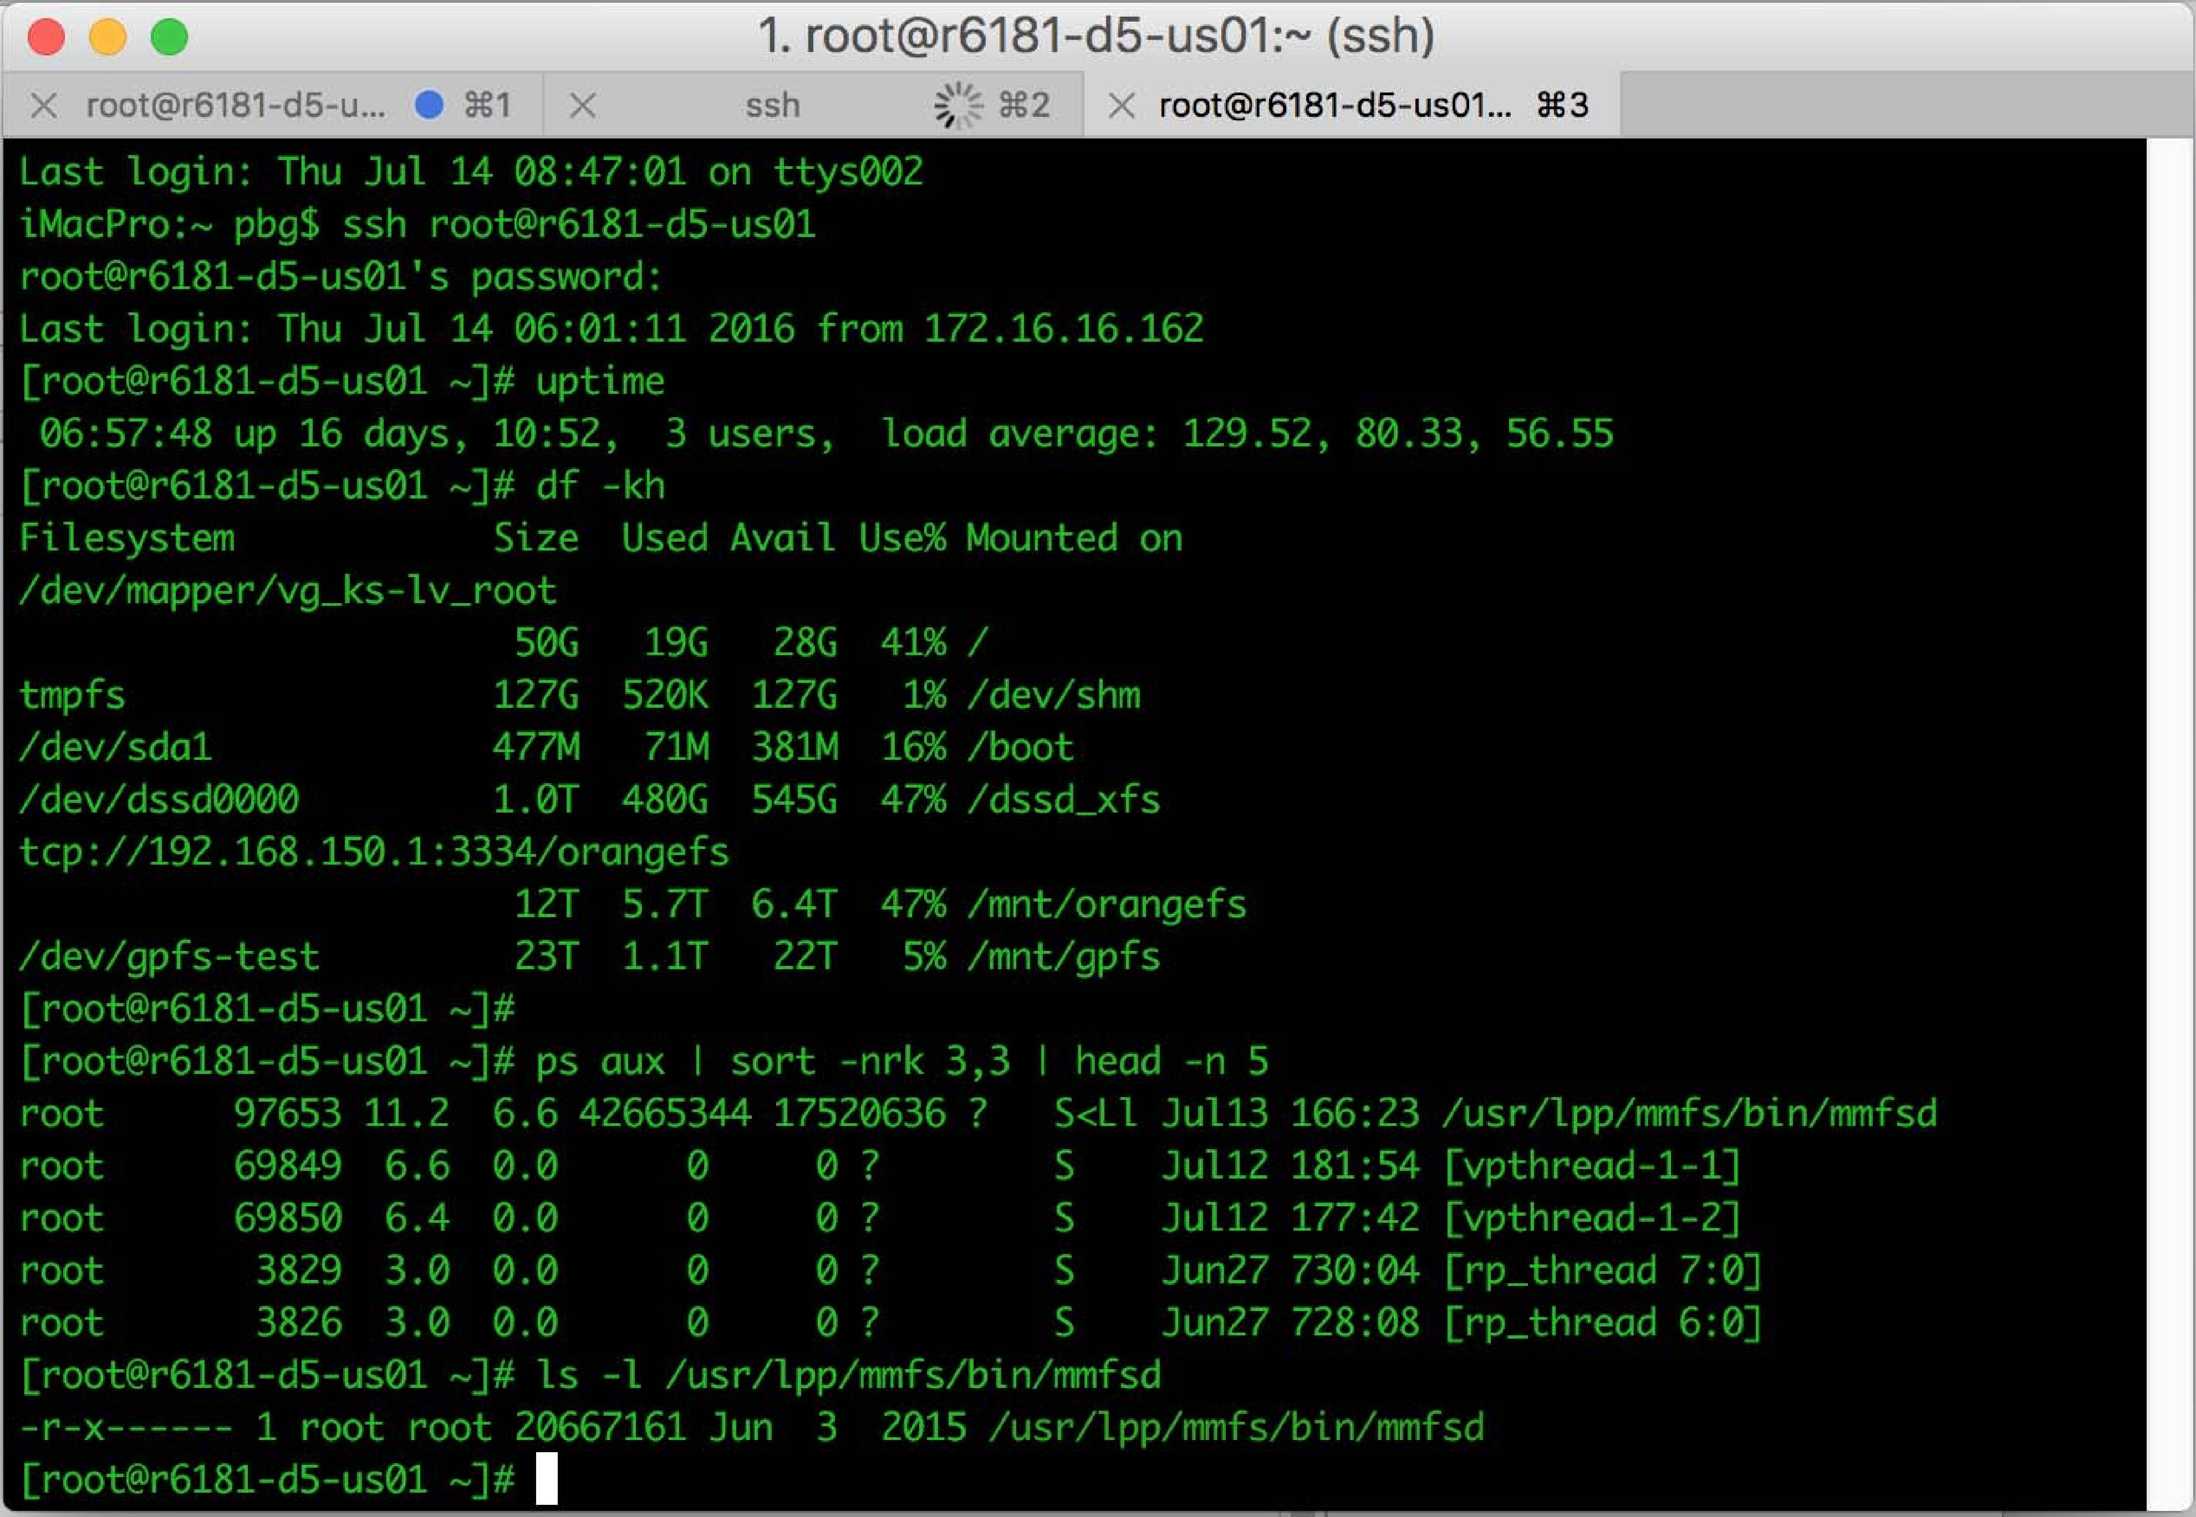
Bourne Shell Command Interpreter

Slide 11
User Operating System Interface - GUI
User-friendly desktop metaphor interface
Usually mouse, keyboard, and monitor
Icons represent files, programs, actions, etc
Various mouse buttons over objects in the interface cause various actions (provide information, options, execute function, open directory (known as a folder)
Invented at Xerox PARC
Many systems now include both CLI and GUI interfaces
Microsoft Windows is GUI with CLI “command” shell
Apple Mac OS X is “Aqua” GUI interface with UNIX kernel underneath and shells available
Unix and Linux have CLI with optional GUI interfaces (CDE, KDE, GNOME)

Slide 12

Touchscreen Interfaces
Touchscreen devices require new interfaces
Mouse not possible or not desired
Actions and selection based on gestures
Virtual keyboard for text entry
Voice commands

Slide 13
The Mac OS X GUI

Slide 14
System calls

Slide 15
System Calls
Programming interface to the services provided by the OS
Typically written in a high-level language (C or C++)
Mostly accessed by programs via a high-level Application Programming Interface (API) rather than direct system call use
Three most common APIs are Win32 API for Windows, POSIX API for POSIX-based systems (including virtually all versions of UNIX, Linux, and Mac OS X), and Java API for the Java virtual machine (JVM)
Note that the system-call names used throughout this text are generic

Slide 16
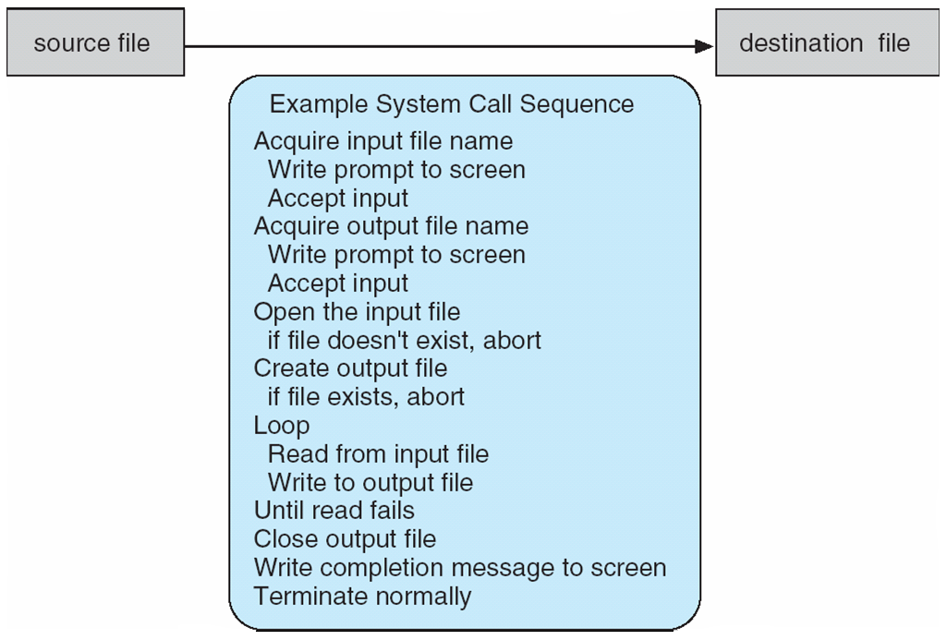
Example of System Calls
System call sequence to copy the contents of one file to another file

Slide 17
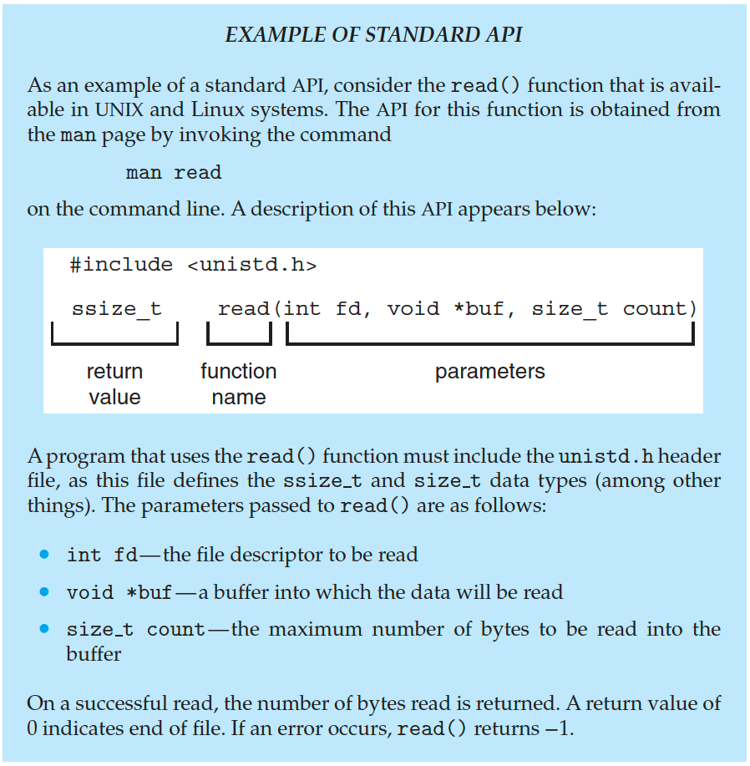
Example of Standard API

Slide 18
System Call Implementation
Typically, a number is associated with each system call
System-call interface maintains a table indexed according to these numbers
The system call interface invokes the intended system call in OS kernel and returns status of the system call and any return values
The caller need know nothing about how the system call is implemented
Just needs to obey API and understand what OS will do as a result call
Most details of OS interface hidden from programmer by API
Managed by run-time support library (set of functions built into libraries included with compiler)

Slide 19

API – System Call – OS Relationship

Slide 20
System Call Parameter Passing
Often, more information is required than simply identity of desired system call
Exact type and amount of information vary according to OS and call
Three general methods used to pass parameters to the OS
Simplest: pass the parameters in registers
In some cases, may be more parameters than registers
Parameters stored in a block, or table, in memory, and address of block passed as a parameter in a register
This approach taken by Linux and Solaris
Parameters placed, or pushed, onto the stack by the program and popped off the stack by the operating system
Block and stack methods do not limit the number or length of parameters being passed

Slide 21
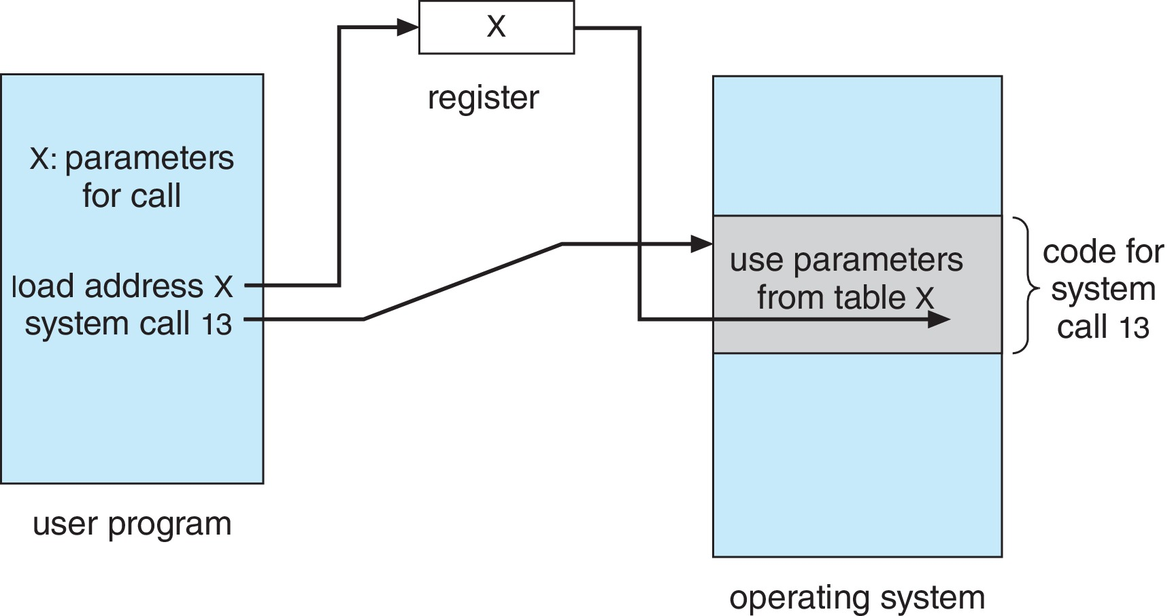
Parameter Passing via Table

Slide 22
Types of System Calls
Process control
create process, terminate process
end, abort
load, execute
get process attributes, set process attributes
wait for time
wait event, signal event
allocate and free memory
Dump memory if error
Debugger for determining bugs, single step execution
Locks for managing access to shared data between processes

Slide 23
Types of System Calls (Cont.)
File management
create file, delete file
open, close file
read, write, reposition
get and set file attributes
Device management
request device, release device
read, write, reposition
get device attributes, set device attributes
logically attach or detach devices

Slide 24
Types of System Calls (Cont.)
Information maintenance
get time or date, set time or date
get system data, set system data
get and set process, file, or device attributes
Communications
create, delete communication connection
send, receive messages if message passing model to host name or process name
From client to server
Shared-memory model create and gain access to memory regions
transfer status information
attach and detach remote devices

Slide 25
Types of System Calls (Cont.)
Protection
Control access to resources
Get and set permissions
Allow and deny user access

Slide 26
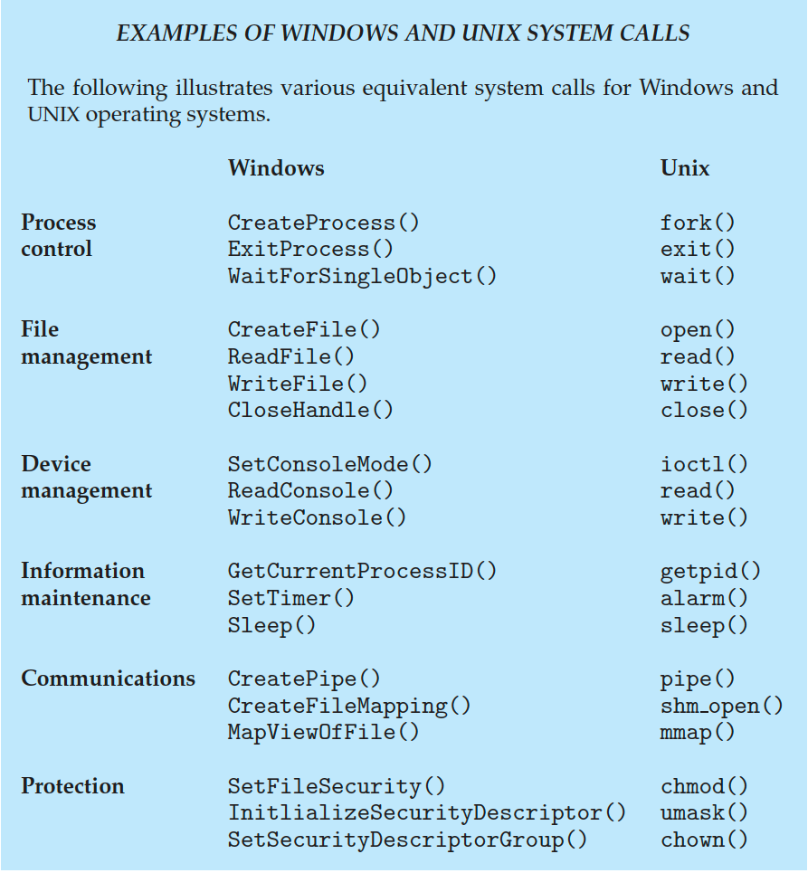
Examples of Windows and Unix System Calls

Slide 27
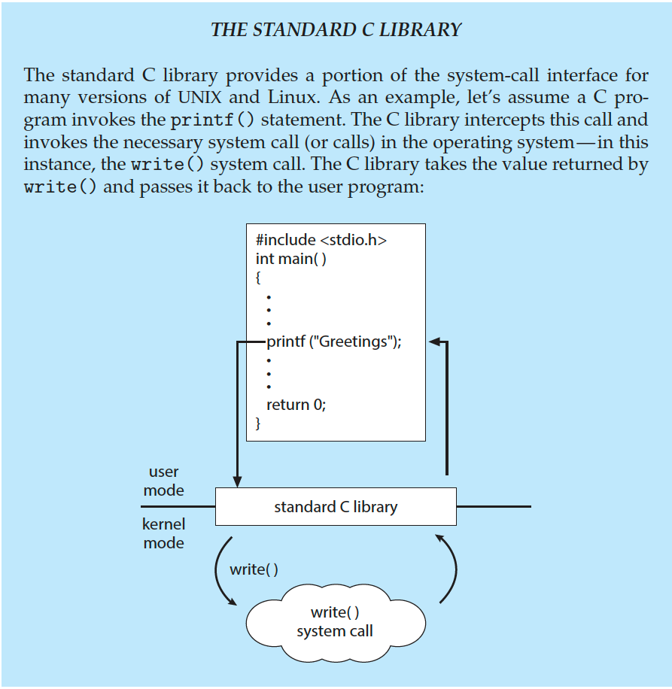
Standard C Library Example
C program invoking printf() library call, which calls write() system call

Slide 28
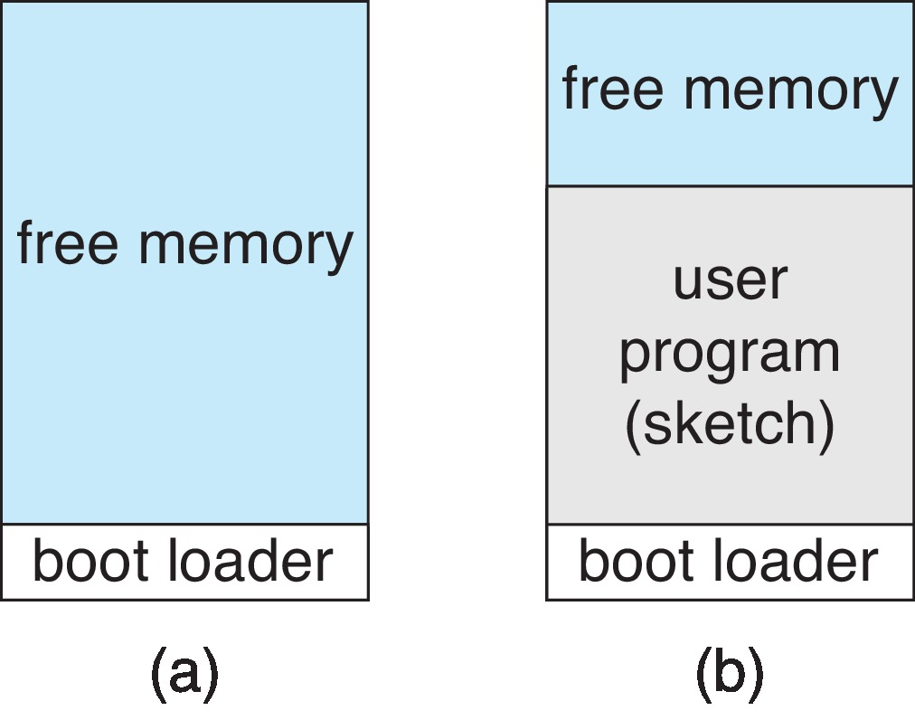
Example: Arduino
Single-tasking
No operating system
Programs (sketch) loaded via USB into flash memory
Single memory space
Boot loader loads program
Program exit -> shell reloaded
At system startup running a program

Slide 29
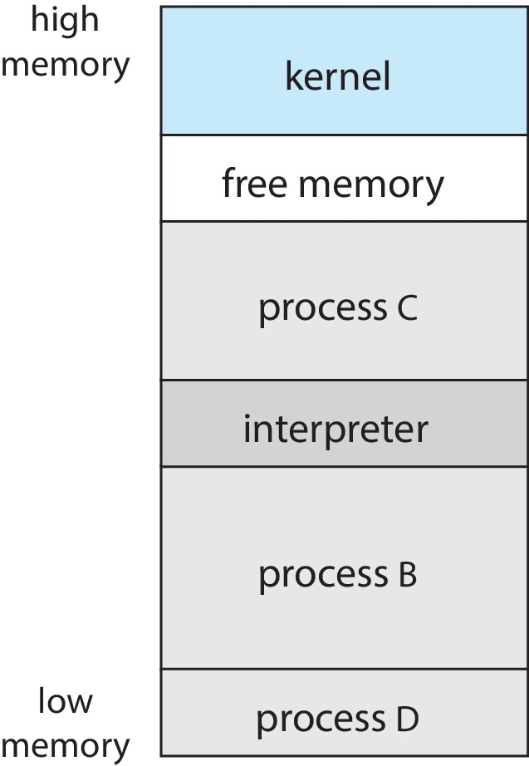
Example: FreeBSD
Unix variant
Multitasking
User login -> invoke user’s choice of shell
Shell executes fork() system call to create process
Executes exec() to load program into process
Shell waits for process to terminate or continues with user commands
Process exits with:
code = 0 – no error
code > 0 – error code

Slide 30
System services

Slide 31
System Services
System programs provide a convenient environment for program development and execution. They can be divided into:
File manipulation
Status information sometimes stored in a file
Programming language support
Program loading and execution
Communications
Background services
Application programs
Most users’ view of the operating system is defined by system programs, not the actual system calls

Slide 32
System Services (Cont.)
Provide a convenient environment for program development and execution
Some of them are simply user interfaces to system calls; others are considerably more complex
File management - Create, delete, copy, rename, print, dump, list, and generally manipulate files and directories
Status information
Some ask the system for info - date, time, amount of available memory, disk space, number of users
Others provide detailed performance, logging, and debugging information
Typically, these programs format and print the output to the terminal or other output devices
Some systems implement a registry - used to store and retrieve configuration information

Slide 33
System Services (Cont.)
File modification
Text editors to create and modify files
Special commands to search contents of files or perform transformations of the text
Programming-language support - Compilers, assemblers, debuggers and interpreters sometimes provided
Program loading and execution- Absolute loaders, relocatable loaders, linkage editors, and overlay-loaders, debugging systems for higher-level and machine language
Communications - Provide the mechanism for creating virtual connections among processes, users, and computer systems
Allow users to send messages to one another’s screens, browse web pages, send electronic-mail messages, log in remotely, transfer files from one machine to another

Slide 34
System Services (Cont.)
Background Services
Launch at boot time
Some for system startup, then terminate
Some from system boot to shutdown
Provide facilities like disk checking, process scheduling, error logging, printing
Run in user context not kernel context
Known as services, subsystems, daemons
Application programs
Don’t pertain to system
Run by users
Not typically considered part of OS
Launched by command line, mouse click, finger poke

Slide 35
Linkers and Loaders
Source code compiled into object files designed to be loaded into any physical memory location – relocatable object file
Linker combines these into single binary executable file
Also brings in libraries
Program resides on secondary storage as binary executable
Must be brought into memory by loader to be executed
Relocation assigns final addresses to program parts and adjusts code and data in program to match those addresses
Modern general purpose systems don’t link libraries into executables
Rather, dynamically linked libraries (in Windows, DLLs) are loaded as needed, shared by all that use the same version of that same library (loaded once)
Object, executable files have standard formats, so operating system knows how to load and start them

Slide 36
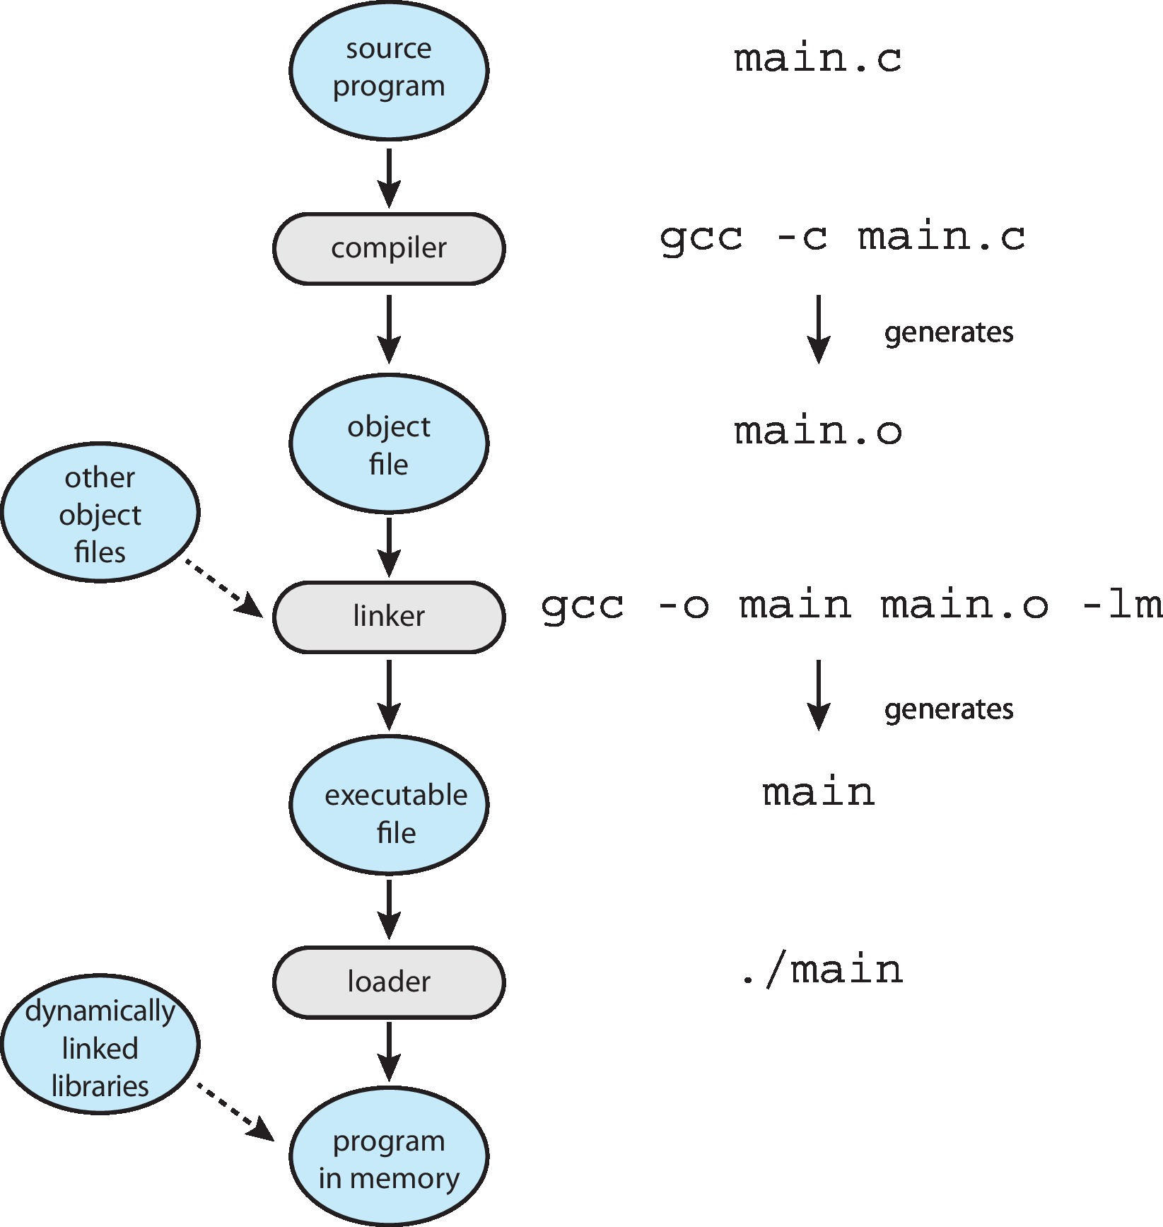
The Role of the Linker and Loader

Slide 37
OS – Design and implementation

Slide 38
Why Applications are Operating System Specific
Apps compiled on one system usually not executable on other operating systems
Each operating system provides its own unique system calls
Own file formats, etc.
Apps can be multi-operating system
Written in interpreted language like Python, Ruby, and interpreter available on multiple operating systems
App written in language that includes a VM containing the running app (like Java)
Use standard language (like C), compile separately on each operating system to run on each
Application Binary Interface (ABI) is architecture equivalent of API, defines how different components of binary code can interface for a given operating system on a given architecture, CPU, etc.

Slide 39
Design and Implementation
Design and Implementation of OS is not “solvable”, but some approaches have proven successful
Internal structure of different Operating Systems can vary widely
Start the design by defining goals and specifications
Affected by choice of hardware, type of system
User goals and System goals
User goals – operating system should be convenient to use, easy to learn, reliable, safe, and fast
System goals – operating system should be easy to design, implement, and maintain, as well as flexible, reliable, error-free, and efficient
Specifying and designing an OS is highly creative task of software engineering

Slide 40
Policy and Mechanism
Policy: What needs to be done?
Example: Interrupt after every 100 seconds
Mechanism: How to do something?
Example: timer
Important principle: separate policy from mechanism
The separation of policy from mechanism is a very important principle, it allows maximum flexibility if policy decisions are to be changed later.
Example: change 100 to 200

Slide 41
Implementation
Much variation
Early OSes in assembly language
Then system programming languages like Algol, PL/1
Now C, C++
Actually usually a mix of languages
Lowest levels in assembly
Main body in C
Systems programs in C, C++, scripting languages like PERL, Python, shell scripts
More high-level language easier to port to other hardware
But slower
Emulation can allow an OS to run on non-native hardware

Slide 42
Operating System Structure
General-purpose OS is very large program
Various ways to structure ones
Simple structure – MS-DOS
More complex – UNIX
Layered – an abstraction
Microkernel – Mach

Slide 43
Monolithic Structure – Original UNIX
UNIX – limited by hardware functionality, the original UNIX operating system had limited structuring.
The UNIX OS consists of two separable parts
Systems programs
The kernel
Consists of everything below the system-call interface and above the physical hardware
Provides the file system, CPU scheduling, memory management, and other operating-system functions; a large number of functions for one level

Slide 44

Traditional UNIX System Structure
Beyond simple but not fully layered

Slide 45

Linux System Structure
Monolithic plus modular design

Slide 46

Layered Approach
The operating system is divided into a number of layers (levels), each built on top of lower layers. The bottom layer (layer 0), is the hardware; the highest (layer N) is the user interface.
With modularity, layers are selected such that each uses functions (operations) and services of only lower-level layers

Slide 47
Microkernels
Moves as much from the kernel into user space
Mach is an example of microkernel
Mac OS X kernel (Darwin) partly based on Mach
Communication takes place between user modules using message passing
Benefits:
Easier to extend a microkernel
Easier to port the operating system to new architectures
More reliable (less code is running in kernel mode)
More secure
Detriments:
Performance overhead of user space to kernel space communication

Slide 48
Microkernel System Structure

Slide 49
Modules
Many modern operating systems implement loadable kernel modules (LKMs)
Uses object-oriented approach
Each core component is separate
Each talks to the others over known interfaces
Each is loadable as needed within the kernel
Overall, similar to layers but with more flexible
Linux, Solaris, etc.

Slide 50
Hybrid Systems
Most modern operating systems are not one pure model
Hybrid combines multiple approaches to address performance, security, usability needs
Linux and Solaris kernels in kernel address space, so monolithic, plus modular for dynamic loading of functionality
Windows mostly monolithic, plus microkernel for different subsystem personalities
Apple Mac OS X hybrid, layered, Aqua UI plus Cocoa programming environment
Below is kernel consisting of Mach microkernel and BSD Unix parts, plus I/O kit and dynamically loadable modules (called kernel extensions)

Slide 51
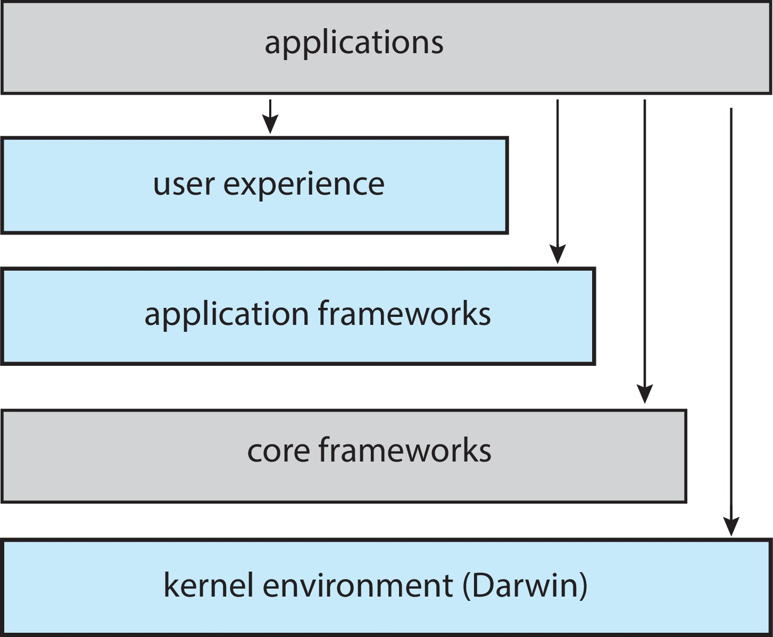
macOS and iOS Structure

Slide 52

Darwin

Slide 53
iOS
Apple mobile OS for iPhone, iPad
Structured on Mac OS X, added functionality
Does not run OS X applications natively
Also runs on different CPU architecture (ARM vs. Intel)
Cocoa Touch Objective-C API for developing apps
Media services layer for graphics, audio, video
Core services provides cloud computing, databases
Core operating system, based on Mac OS X kernel

Slide 54
Android
Developed by Open Handset Alliance (mostly Google)
Open Source
Similar stack to iOS
Based on Linux kernel but modified
Provides process, memory, device-driver management
Adds power management
Runtime environment includes core set of libraries and Dalvik virtual machine
Apps developed in Java plus Android API
Java class files compiled to Java bytecode then translated to executable thnn runs in Dalvik VM
Libraries include frameworks for web browser (webkit), database (SQLite), multimedia, smaller libc

Slide 55
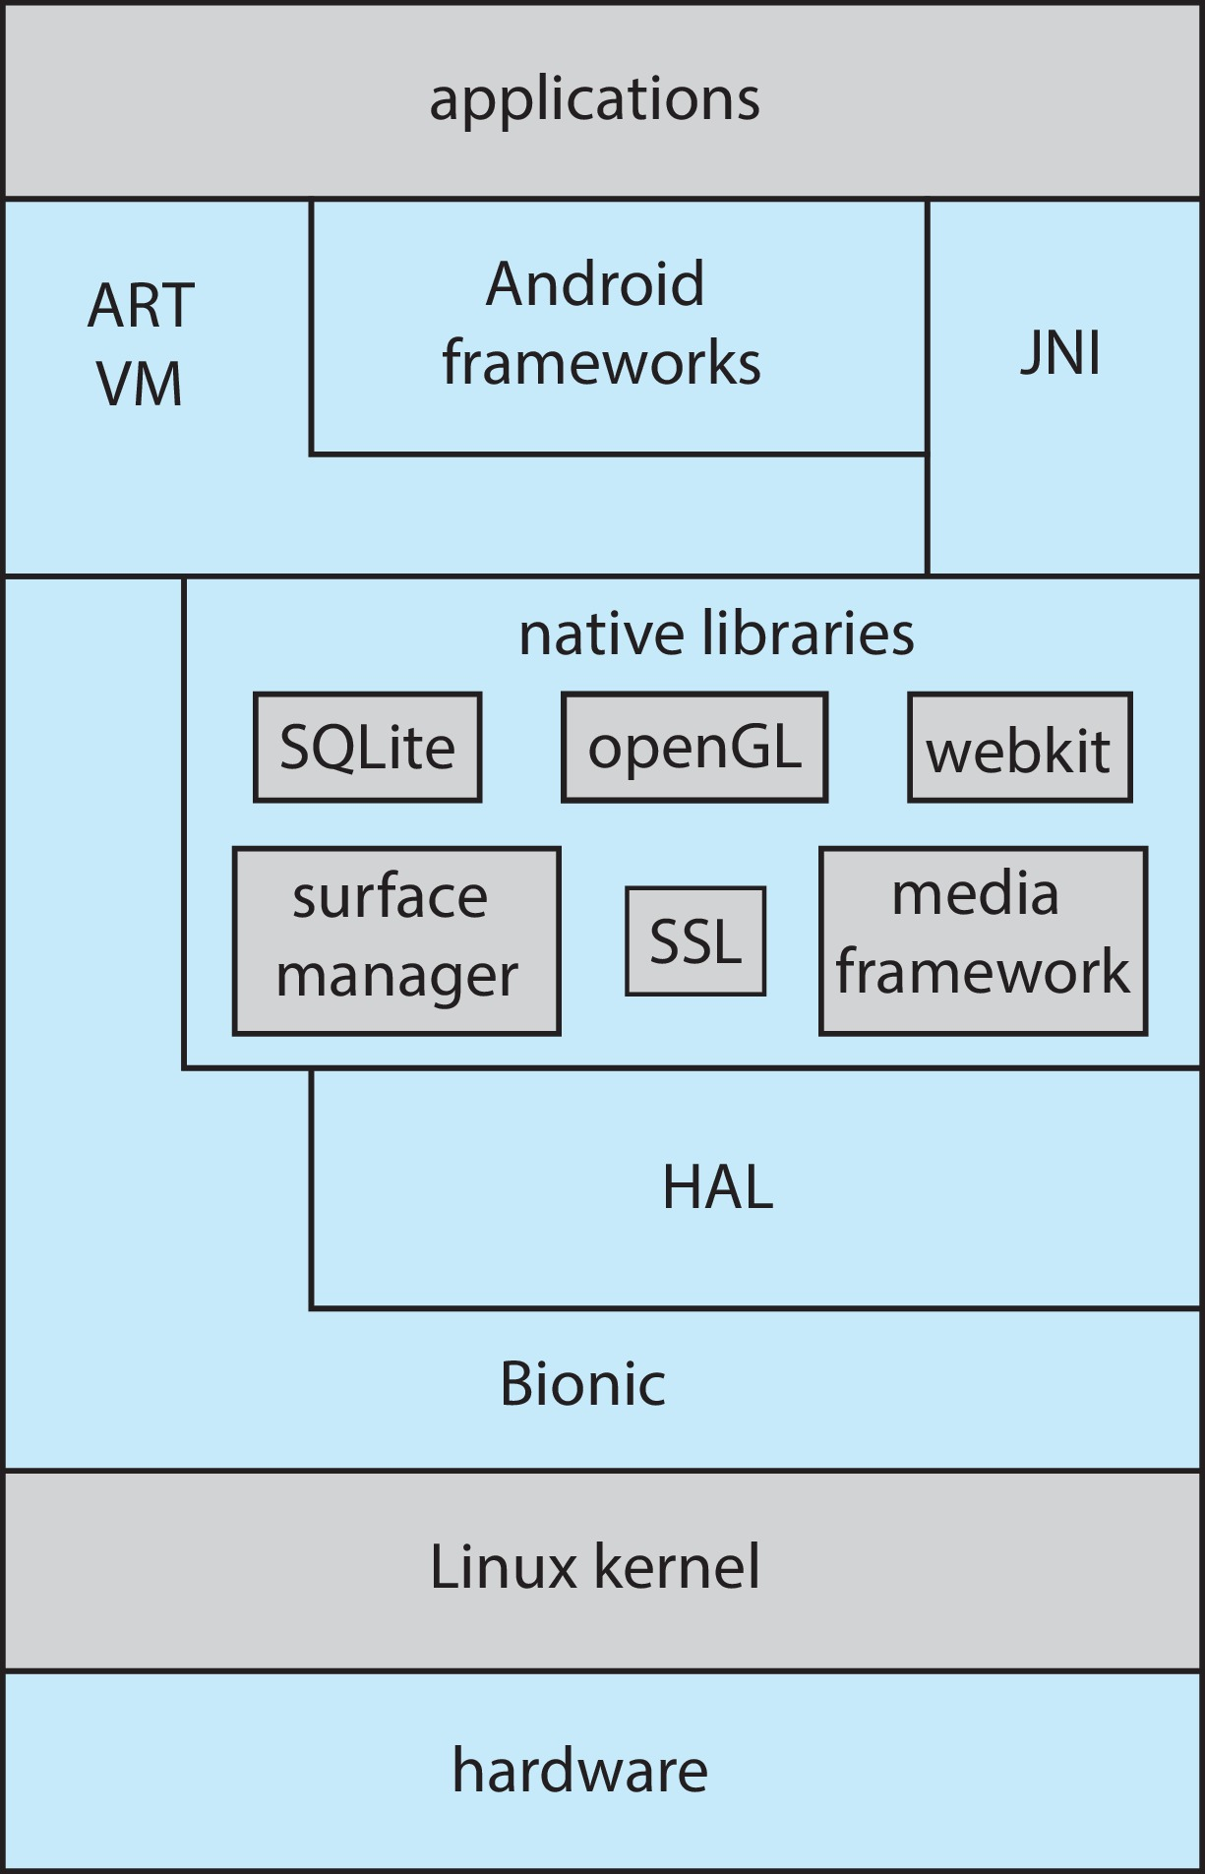
Android Architecture

Slide 56
BOOTING

Slide 57
Building and Booting an Operating System
Operating systems generally designed to run on a class of systems with variety of peripherals
Commonly, operating system already installed on purchased computer
But can build and install some other operating systems
If generating an operating system from scratch
Write the operating system source code
Configure the operating system for the system on which it will run
Compile the operating system
Install the operating system
Boot the computer and its new operating system

Slide 58
Building and Booting Linux
Download Linux source code (http://www.kernel.org)
Configure kernel via “make menuconfig”
Compile the kernel using “make”
Produces vmlinuz, the kernel image
Compile kernel modules via “make modules”
Install kernel modules into vmlinuz via “make modules_install”
Install new kernel on the system via “make install”

Slide 59
System Boot
When power initialized on system, execution starts at a fixed memory location
Operating system must be made available to hardware so hardware can start it
Small piece of code – bootstrap loader, BIOS, stored in ROM or EEPROM locates the kernel, loads it into memory, and starts it
Sometimes two-step process where boot block at fixed location loaded by ROM code, which loads bootstrap loader from disk
Modern systems replace BIOS with Unified Extensible Firmware Interface (UEFI)
Common bootstrap loader, GRUB, allows selection of kernel from multiple disks, versions, kernel options
Kernel loads and system is then running
Boot loaders frequently allow various boot states, such as single user mode

Slide 60
debugging

Slide 61
Operating-System Debugging
Debugging is finding and fixing errors, or bugs
Also performance tuning
OS generate log files containing error information
Failure of an application can generate core dump file capturing memory of the process
Operating system failure can generate crash dump file containing kernel memory
Beyond crashes, performance tuning can optimize system performance
Sometimes using trace listings of activities, recorded for analysis
Profiling is periodic sampling of instruction pointer to look for statistical trends
Kernighan’s Law: “Debugging is twice as hard as writing the code in the first place. Therefore, if you write the code as cleverly as possible, you are, by definition, not smart enough to debug it.”

Slide 62
Performance Tuning
Improve performance by removing bottlenecks
OS must provide means of computing and displaying measures of system behavior
For example, “top” program or Windows Task Manager

Slide 63
Tracing
Collects data for a specific event, such as steps involved in a system call invocation
Tools include
strace – trace system calls invoked by a process
gdb – source-level debugger
perf – collection of Linux performance tools
tcpdump – collects network packets

Slide 64

BCC
Debugging interactions between user-level and kernel code nearly impossible without toolset that understands both and an instrument their actions
BCC (BPF Compiler Collection) is a rich toolkit providing tracing features for Linux
See also the original DTrace
For example, disksnoop.py traces disk I/O activity
Many other tools (next slide)

Slide 65
Linux bcc/BPF Tracing Tools

Slide 66
End of Chapter 2

